Slide 1
Ciphering and Deciphering Data in PDCP Group 3 Specification 38.323 Mentored by :- Abhijeet sir
• Role: Encrypts and decrypts data for secure transmission.
• Significance: Ensures data privacy and security.

Slide 2
Presented By:-
Bhakti S
Ranjita Karadad
Ritesh Mishra
Vaidehi Shailendra Bhosale
Vanaja Dukka
Vivek Kumar
Yash Pramod Gulhane
Yengala Dharmendra Kumar Reddy

Slide 3
Contents
Introduction of PDCP
Role of Ciphering in PDCP
Ciphering Process in PDCP
Role of Deciphering in PDCP
Deciphering Process in PDCP
Significance of Ciphering and Deciphering
Key Management in PDCP
Challenges and Considerations
Code
Conclusion

Slide 4
Introduction
PDCP(Packet Data Convergence Protocol) is a layer 2 protocol in the 5G network architecture.
PDCP plays a crucial role in ensuring reliable and secure data transfer between the device (UE) and the network (gNodeB).
PDCP is a vital component of the 5G network, ensuring secure, reliable, and efficient data transfer between devices and the network.
It is responsible for handling the transmission of user data and control information across the radio interface.

Slide 5
Functions of PDCP
1. Header compression and decompression
2. Data encryption and decryption
3. Integrity protection and verification
4. Sequence numbering and reordering
5. Duplicate detection and removal
Key Feature of PDCP
1. Enhanced security: Improved encryption and integrity protection mechanisms
2. Efficient header compression: Reduced overhead for better performance
3. Robust sequence numbering: Ensures correct data ordering and reordering
4. Improved duplicate detection: Eliminates duplicate packets for better efficiency

Slide 6
Position un the Network Stack
* Location: PDCP is situated above the Radio Link Control (RLC) layer and below the Packet Data Network (PDN) layer in the mobile network architecture.
*Interaction with Other Layers:
-RLC Layer: PDCP interacts closely with the RLC layer, which handles the segmentation and reassembly of data packets. While RLC is responsible for reliable transmission, PDCP focuses on data optimization and security.
-Network Layer (PDN): PDCP serves as the interface to the network layer, ensuring that compressed and encrypted data is appropriately packaged for transmission to external networks or services.

Slide 7
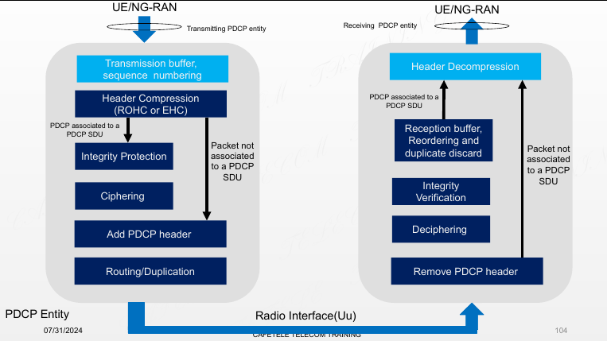
Diagram

Slide 8
Process of PDCP:-
Transmission buffer & sequence number.
Header Compression.
Integrity protection.
Ciphering
Add PDCP header
Routing/Duplication
Remove PDCP Header
Deciphering
Integrity Verification
Header Decompression

Slide 9
Role of Ciphering in PDCP
Ciphering:-Ciphering refers to the process of converting plaintext data into an unreadable format through encryption. This ensures that the data remains confidential and is protected from unauthorized access during transmission.
Role of Ciphering in PDCP:-Ciphering is a critical component of the Packet Data Convergence Protocol (PDCP) in 5G networks. It ensures the confidentiality and integrity of data transmitted between the device (UE) and the network (gNodeB).
Encryption:-Encryption is the process of converting plaintext data into ciphertext to ensure confidentiality and integrity. It uses an encryption algorithm and a secret key to transform the data, making it unreadable to unauthorized parties.

Slide 10
Purpose of Ciphering:-
1. Protect data from unauthorized access
2. Maintain data confidentiality
3. Ensure data integrity

Slide 11
Ciphering Process in PDCP
Process of Ciphering in PDCP
Data Arrival: Data arrives at the PDCP layer from the RLC layer.
Encryption: The data is encrypted using a symmetric key encryption algorithm and a secret key.
Ciphering: The encrypted data is then ciphered using a ciphering algorithm
Header Addition: A ciphered header is added to the encrypted data.
Transmission: The ciphered data is transmitted to the receiving end.
Deciphering: The receiving end deciphers the data using the same secret key and ciphering algorithm.
Decryption: The decrypted data is then decrypted using the same encryption algorithm and secret key.

Slide 12
Role of Deciphering in PDCP
Role of Deciphering in PDCP:-Deciphering is the process of decrypting encrypted data in the Packet Data Convergence Protocol (PDCP) layer, restoring it to its original form for authorized access.
Deciphering:-Deciphering is the process of converting ciphertext (encrypted data) back into plaintext (original data) using a decryption algorithm and a secret key.
Deciphering, also known as decryption.
Decryption:-Decryption is the process of transforming ciphertext into plaintext, making it readable and accessible to authorized entities.

Slide 13
Purpose of Deciphering:
1. Restore data to its original form for authorized access
2. Ensure data confidentiality and integrity
3. Enable secure data transmission and reception

Slide 14
Deciphering Process in PDCP
Process of Deciphering in PDCP:
Encrypted Data Reception: Encrypted data is received at the PDCP layer.
Key Selection: The appropriate decryption key is selected.
Decryption: Encrypted data is decrypted using the selected key and algorithm
Deciphering: Decrypted data is deciphered using the same ciphering algorithm used during encryption.
Header Removal: The ciphered header is removed.
Data Restoration: The original data is restored and made available to the upper layers.

Slide 15
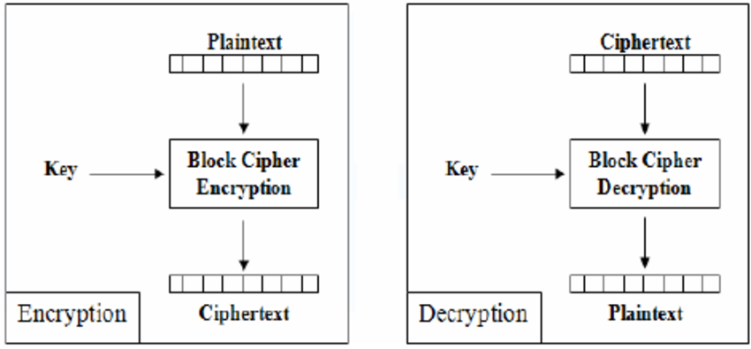
Ciphering and Deciphering

Slide 16
Significance of Ciphering and Deciphering
The significance of ciphering and deciphering lies in:
Data Privacy:-Ciphering encrypts data so that it is accessible only to authorized users. This prevents unauthorized parties from reading or interpreting sensitive information.
Data Integrity:-Integrity checks ensure that the data has not been modified or tampered with during transmission. This helps in verifying that the data received is the same as the data sent.
Protect Against Attackers:-Ciphering and deciphering protect against various forms of cyber attacks, including eavesdropping (unauthorized data interception) and tampering (unauthorized data modification).
Benefits:-
-Authentication: Ensuring the authenticity of data and its source.
- Non-Repudiation: Ensuring that a sender cannot deny sending the data.
-Compliance: Meeting regulatory requirements for data security and privacy.

Slide 17
Key Management in PDCP
Key Types:
1.Session keys: Temporary keys used for a specific session or transaction.
2.Long-term keys: Persistent keys used for an extended period.
Key Lifecycle:
1. Generation:-The process of creating secure keys using algorithms that ensure randomness and robustness. Using secure random number generators to create keys that are difficult to predict or reproduce.
2. Distribution:-Keys are distributed using secure channels to prevent interception or unauthorized access.
3. Rotation: Keys are regularly updated and replaced to prevent compromise.
4. Destruction: Keys are securely deleted or destroyed when no longer needed

Slide 18
Security Measures
Ensuring Key Security and Integrity
-Storage: Keys are stored in secure hardware modules or encrypted databases to protect against unauthorized access.
-Access Control: Only authorized entities or systems can access or manage the keys.
-Monitoring: Regular monitoring of key usage and access logs to detect any unauthorized activities or breaches.
-Backup: Secure backups of keys are maintained to ensure recovery in case of data loss or system failures.

Slide 19
Challenges and Considerations
Performance Impact
-Processing Time: Encryption and decryption processes consume computational resources, potentially affecting the speed and responsiveness of data transmission.
-Latency: The time required to encrypt and decrypt data can introduce delays, impacting real-time applications like voice and video streaming.
Resource Usage: Additional CPU and memory usage for cryptographic operations may strain network devices, especially in high-throughput scenarios.
Scalability Issues
-Key Management Complexity: As the network grows, managing and distributing a large number of keys becomes increasingly complex. This includes ensuring secure key storage, distribution, and rotation.

Slide 20
-Increased Overhead: Large networks require more robust systems for encryption and decryption, leading to higher resource consumption and potential bottlenecks.
-Scalability Solutions: Implementing scalable key management systems and efficient cryptographic algorithms can help mitigate these challenges.

Slide 21
Ciphering and Deciphering Code

Slide 22
Conclusion
Enhanced Security: Ciphering and deciphering are fundamental to secure data transmission in modern communication networks, providing robust protection against unauthorized access and tampering.
Ongoing Evolution: As technology advances, encryption methods and key management practices will continue to evolve, adapting to new security challenges and ensuring the integrity of data communications.
Importance of Best Practices: Implementing best practices in ciphering and deciphering helps maintain a high level of security and efficiency in data handling, ensuring that sensitive information remains protected throughout its lifecycle.

Slide 23
Thank you

